Slide 1
Swine Farm Assessor by ZINPRO

Slide 2
Key data to control:
Number of users
Number of users that opened the software in the last 60 days
Number of farms (stats on zones etc.)
Number of new farms since Xdays

Slide 3
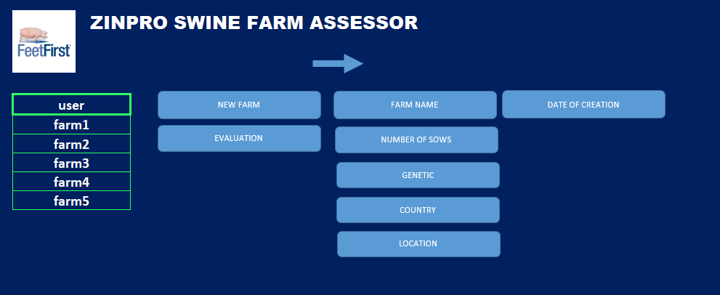

Slide 4
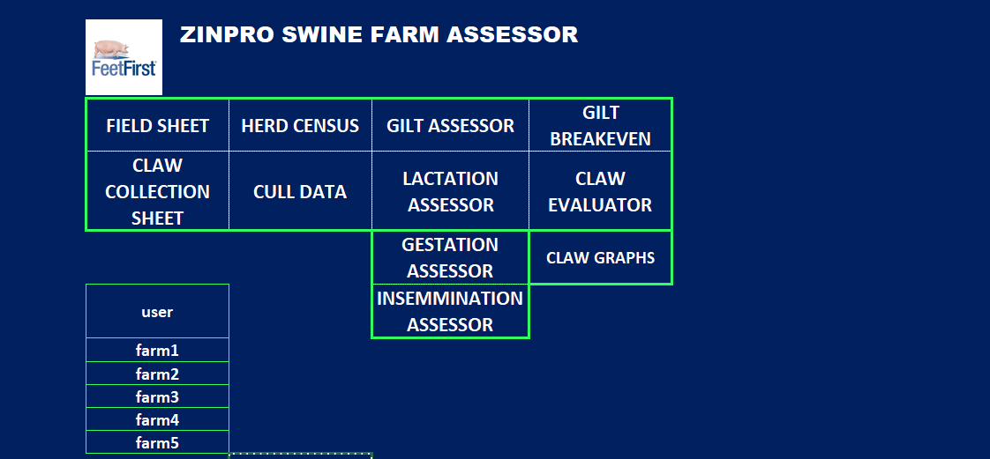

Slide 5
Field sheet
OBS- it is just a PDF for print if necessary

Slide 6
Claw collection sheet
OBS: a PDF for printing in case the Ipad is not authorized to enter the farm

Slide 7
Herd Census block
Obs: spreadsheet to edit only the Green cells, IT SHOUL ALLOW TO COMPARE 2 GRAPHS FROM 2 DIFFERENT EVALUATIONS WITHIN THE SAME FARM (NOT DIFFERENT FARMS)

Slide 8
Cull Data block
Obs: spreadsheet with editable Green cells, IT MUST ALSO ALLOW TO COMPARE 2 EVALUTAIONS DONE IN THE SAME FARM

Slide 9
Gilt assessor block
Obs: here the user can fill the scores only with 4 possibilities, not to score, score 1, 2 or 3 and edit comments for each parameter scored.
Allow to add photos

Slide 10
Lactation assessor block
Obs: here the user can fill the scores only with 4 possibilities, not to score, score 1, 2 or 3 and edit comments for each parameter scored.
Allow to add photos

Slide 11
Gestation assessor block
Obs: here the user can fill the scores only with 4 possibilities, not to score, score 1, 2 or 3 and edit comments for each parameter scored.
Allow to add photos

Slide 12
Gestation assessor block
Obs: here the user can fill the scores only with 4 possibilities, not to score, score 1, 2 or 3 and edit comments for each parameter scored.
Allow to add photos

Slide 13
Gilt breakeven assessor block
Obs: here the user can fill the Green cells. No need for graph simultaneous comparisons

Slide 14
Claw lesion assessor block
Obs: The user should insert data related to the claw evaluation the fields are : sow ID (not mandatory), sow parity, All the noted lesions are from 0 to 3 and for potentially 2 feet. The lesion are: White line, Sole heel Crack, Vertical crack, horizontal crack, Heel erosion, Toe overgrowth and dew claw overgrowth.
Allow to add photos

Slide 15
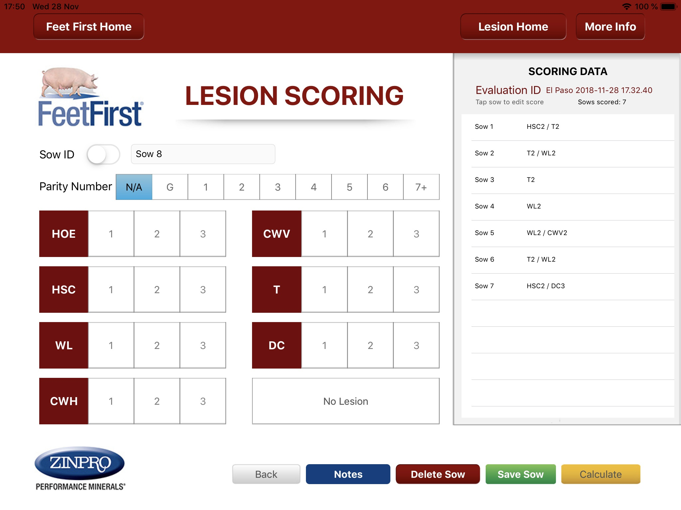
This lesion register system Works well

Slide 16
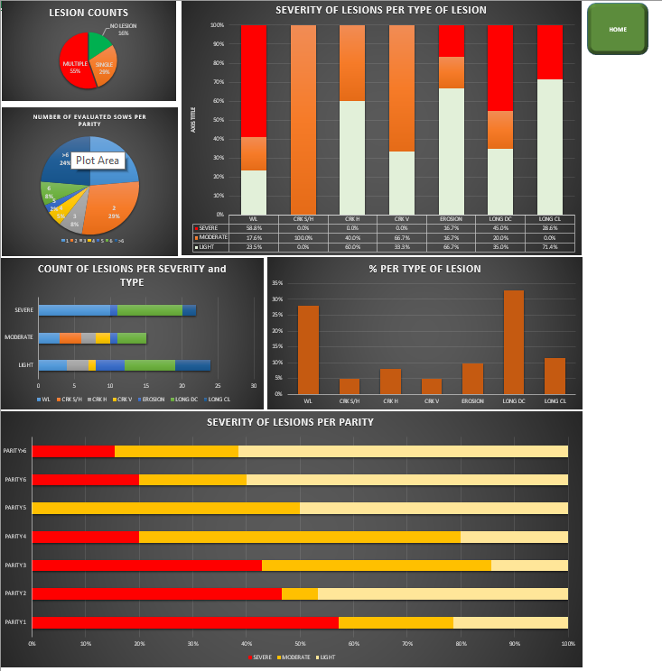
Claw lesion graphs:
Obs: it should allow to compare 2 different evaluations. The key graphs are:
Lesion counts number of sows with no lesion, 1 lesion and more than 1
Severity of lesions (1,2 and 3) per type of lesion
Number of evaluated sows per parity
Count of lesions per severity and type
% per lesion type
Severity of lesions per parity

Slide 17
FARM REPORT:
Date, user, farm data
It should allow to add edit final notes and choose which graphs and tables are to be printed
Photos and comments could also be an advantage

Slide 18

This is the Zinpro logo and colors

